Slide 1

Alpha Anywhere Q&A
March 2, 2022

Slide 2


Slide 3

Register at www.alphasoftware.com/devcon2022

Slide 4

Branding
Overview of customizing your application's look and feel in Alpha Anywhere

Slide 5
Terminology
Style – the visual design of elements in your app: colors, layouts, and fonts
CSS – Cascading Style Sheets, the language used to define styles
SASS – Syntactically Awesome Style Sheets, an extension for CSS that adds functions, nesting, variables, and more
Web Theme – a collection of SASS, CSS, images, and JavaScript used to style an Alpha Anywhere web or mobile app
SASS Theme – another term for an Alpha Anywhere Web Theme

Slide 6
Web Themes Overview
Style both web and mobile applications.
Alpha Anywhere built-in Web Themes:
Alpha
AndroidLight
AndroidDark
iOS
Alpha theme has 17 variations

Slide 7

How do I Customize Web Themes
Web Themes are customized in Alpha Anywhere using CSS and SASS
There are a wide range of tools for making global to local style changes in your app
Some tools provide Builders for creating the CSS/SASS required to customize your app

Slide 8
Customizing Your App
Global
Web Theme Builder
Inherited Styles
Style Tweaks
Color Palettes
Component
Sub-themes
Component CSS
Local
Control Properties
Control CSS
In-line CSS

Slide 9

Global Theme Changes
Style Tweaks
Color Palettes
Creating an Inherited Theme
Or creating a Custom Theme

Slide 10
Anatomy of a Web Theme
Parts
Set of Properties
Colors, Fonts, Spacing, Images, etc
A control or component
One or more Sub-themes
Can be Nested in other Parts
Defined on the Code Tab
Variables
SASS variables that define global properties
Colors, Fonts, Spacing
Defined on the Adjust Tab

Slide 11
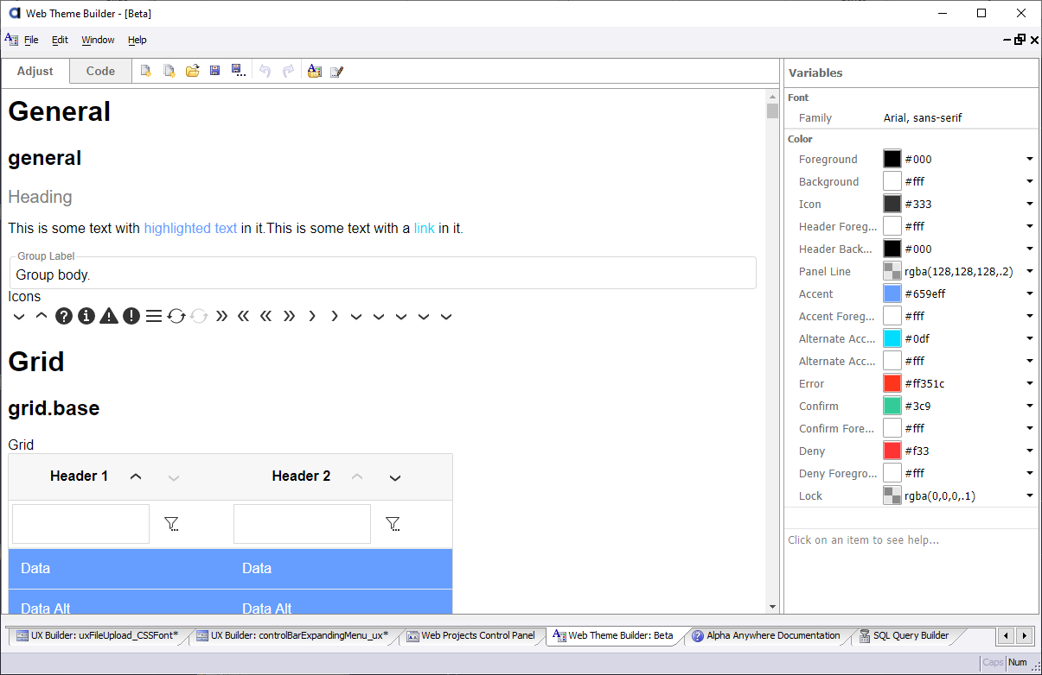
Web Theme Builder

Slide 12
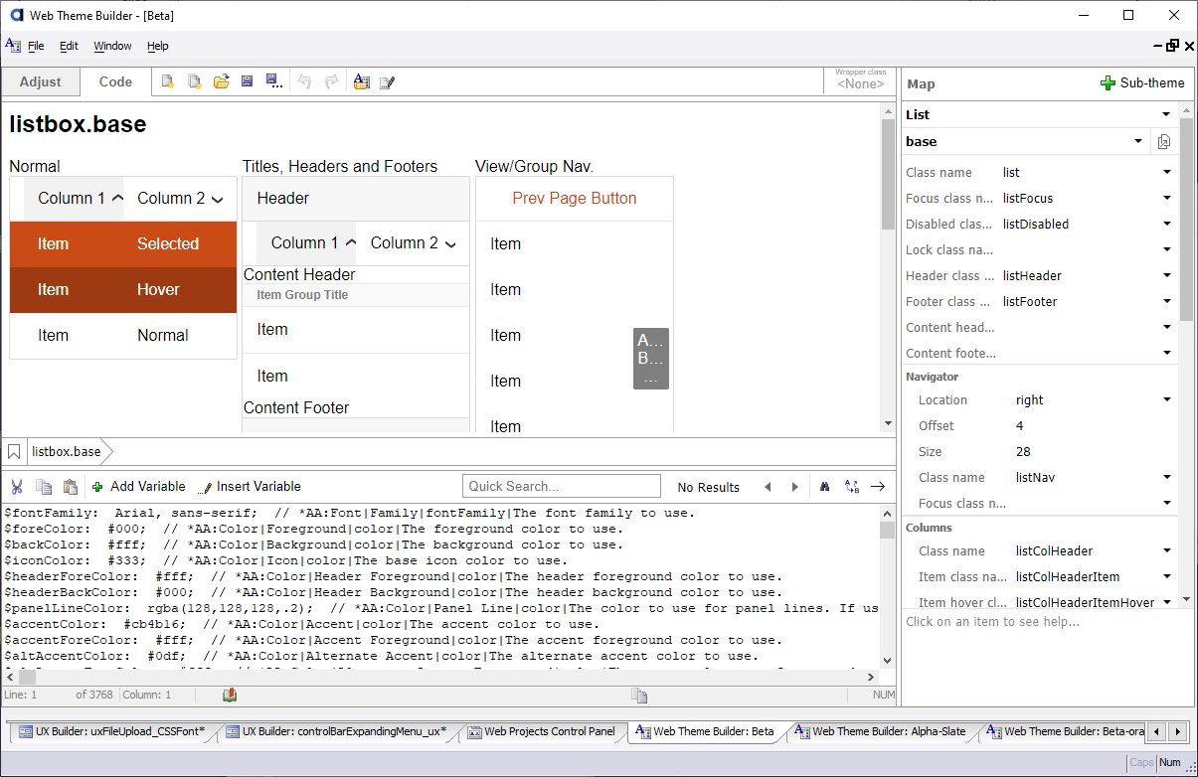
Web Theme Builder

Slide 13
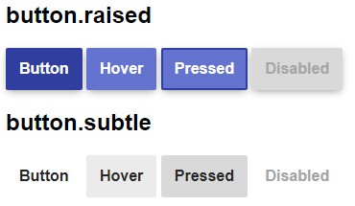

Sub-Themes
Reusable Variation on a Web Theme Part
All Parts have a “base” Sub-Theme – Default
Can be part of the Web Theme or a Style Tweak

Slide 14
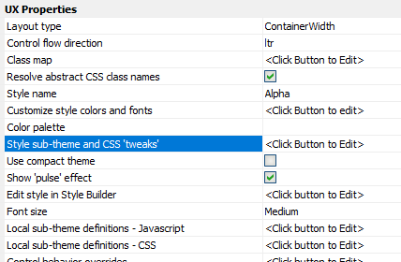
Style Tweaks
Overwrite Web Theme
Stored in the Project
Affect the entire Project
Can include Sub-themes, CSS, SASS

Slide 15
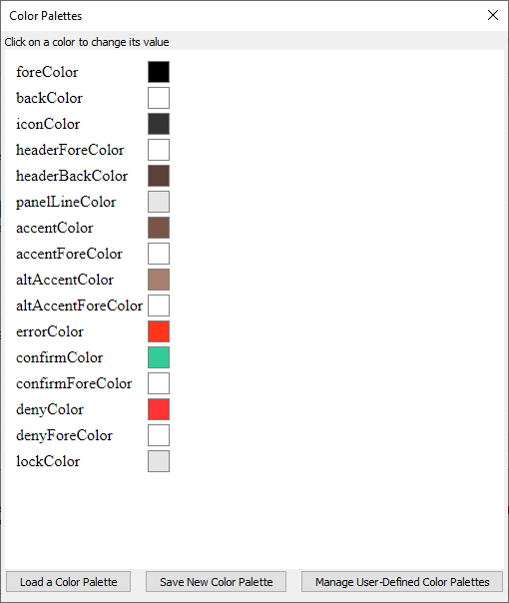
Color Palettes
Overwrite Web Theme
Stored in the Project
Affect the entire Project
Can include Sub-themes, CSS, SASS

Slide 16
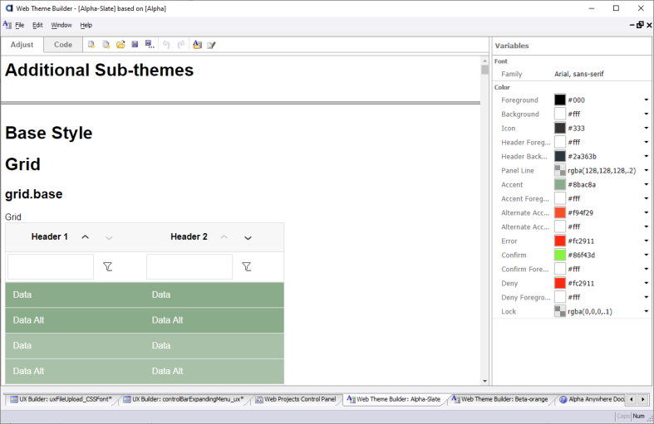
Inherited Theme
A named Style Tweak
Based on an existing Web Theme
Saved as a Local or Global Web Theme
Local = Project
Global = Workspace

Slide 17
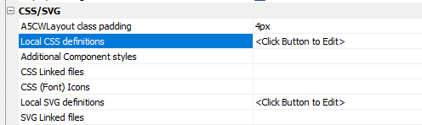
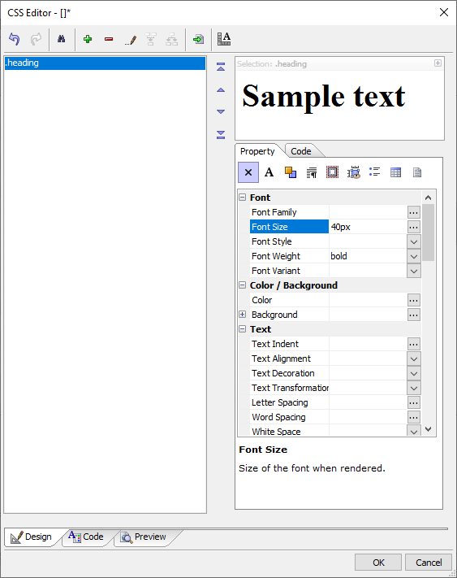
Component CSS/SASS
Stored with the component
Affects entire app only when the Component is loaded
CSS Builder

Slide 18
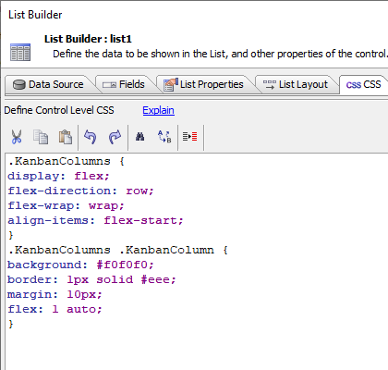
Control CSS
List, ViewBox, ControlBar
Stored in the Control’s Definition
Namespaced to the Control – can only affect the control

Slide 19
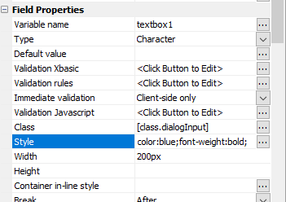
Control Properties & CSS
Defined on the Control
Stored with the Control
Width, Height, Style, Class
In-line Style, Classname

Slide 20
Useful Documentation
How to Add a Class and Reference it in a Control
How to Add Local and Global Shared Styles
How to Create and Assign a Sub-theme
How to Add a Web Font to Your Project
How to Configure the Project Style to use the Compact or Pulse Options
How to Define Style Tweaks
How to Preview Themes in Other Contexts in the Web Theme Builder
How to Set the Height of a Container to the Screen Height
Alpha Web Theme Builder
Customizing Colors and Fonts
Inherited Styles
The Pulse Effect
Sub-themes

